Slide 1



Project on Energy Consumption & Emission SQL Project
SQL Database | Analysis & Insights
PRESENTED BY:
Moturi Kiran Sai
Amudalapalli Lakshman
Sivvala Ganesh

Slide 2


Objectives of Project
• Build a database to analyze global energy consumption, production, GDP, and emissions.
• Understand energy usage trends across countries.
• Identify top contributors to emissions and GDP.
• Analyze population impact on energy consumption.
• Provide global comparisons and key insights for sustainability.

Slide 3
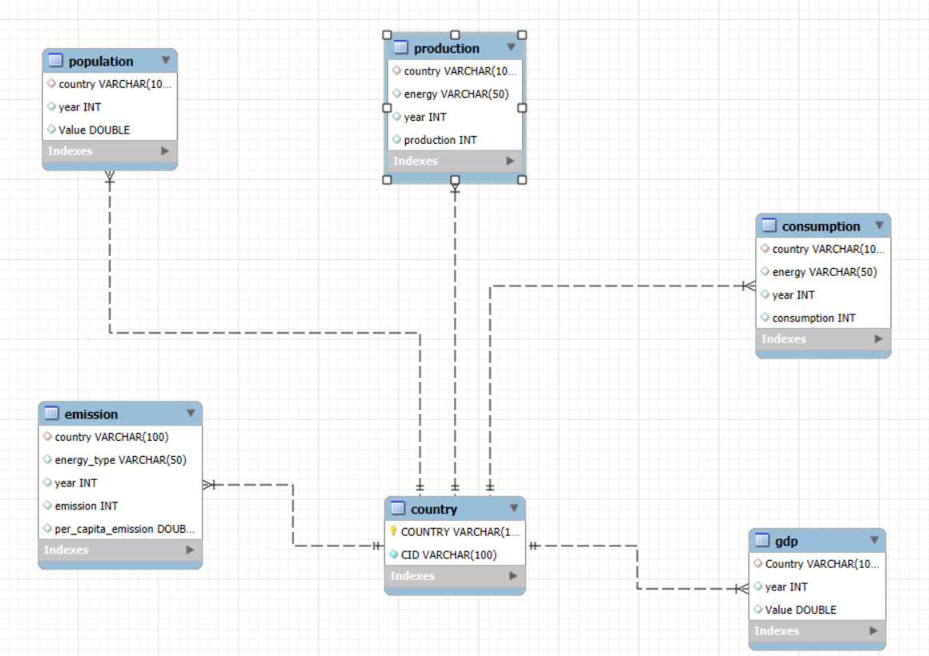
Database Schema & ER Diagram
• Tables: Country, Emission, Population, Production, GDP, Consumption.
Relationships ensure data integrity across years.
• Key Relationships:
- Country ↔ Emission, Production, Consumption
- Population ↔ Country
- GDP ↔ Country

Slide 4

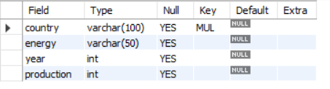
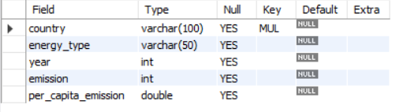

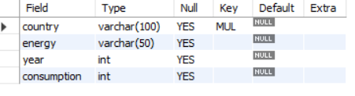

Tables

Slide 5
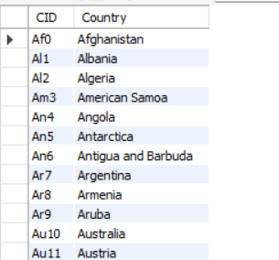
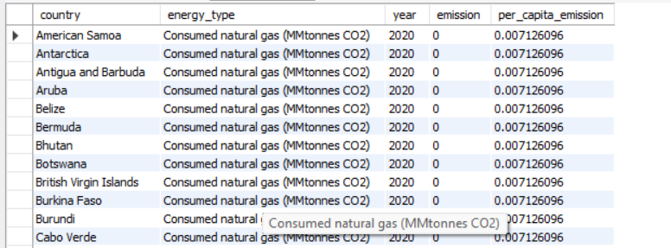
After Inserting Table
COUNTRY TABLE
EMISSION TABLE

Slide 6
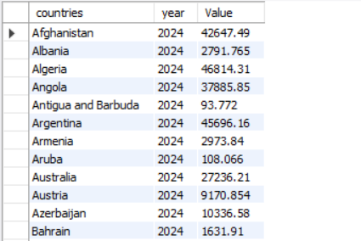
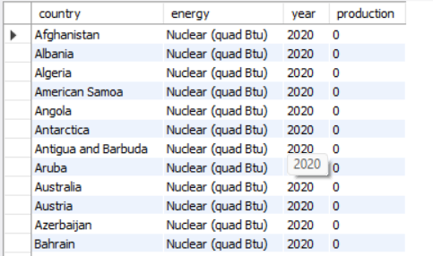
POPULATION TABLE
PRODUCTION TABLE

Slide 7
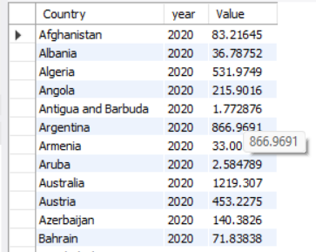
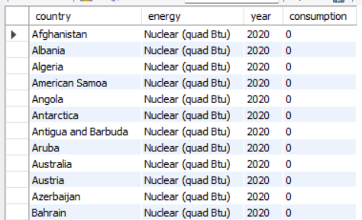
GDP TABLE
CONSUMPTION TABLE

Slide 8
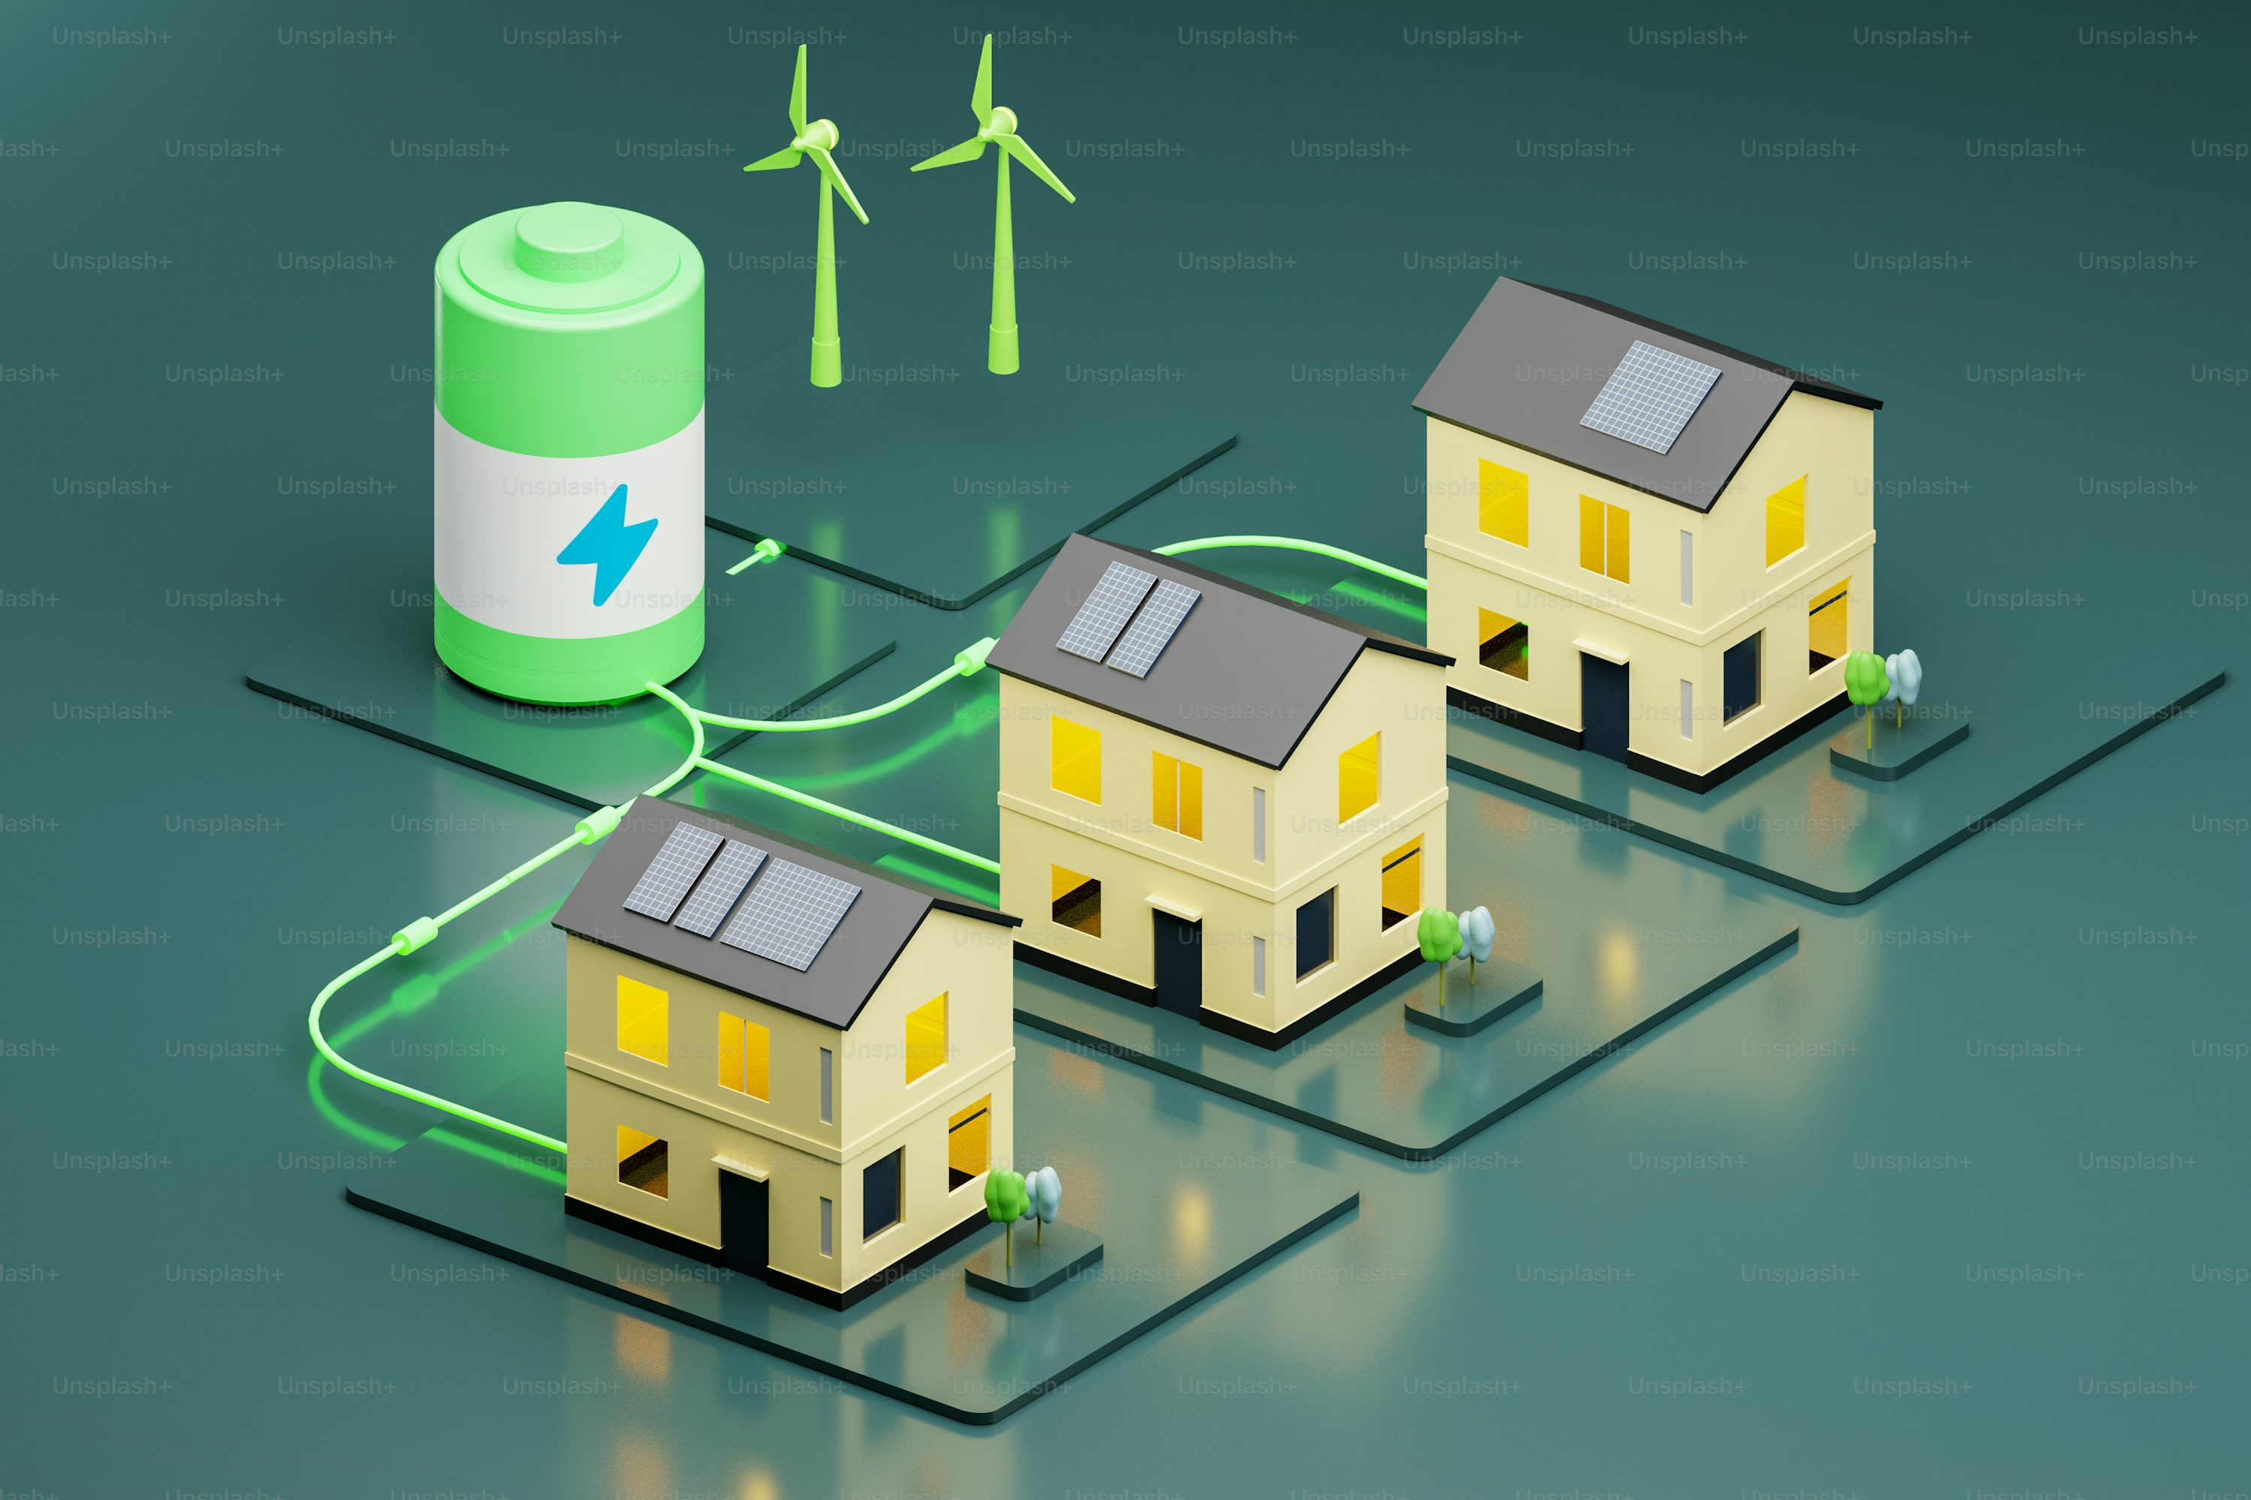
Key Analysis Questions (Use Cases)
• What is the total emission per country?
• Top 5 countries by GDP in the latest year.
• Energy production vs consumption (Net Energy).
• Trends in emissions, GDP, and population over years.
• Energy consumption per capita over the last decade.
• Energy production per capita across countries.
• Countries with highest consumption relative to GDP.
• Top 10 most populated countries and their emissions.
• Countries reducing per capita emissions over time.

Slide 9
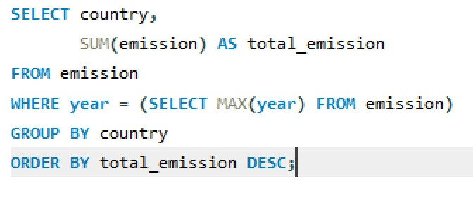
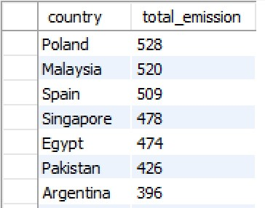
What is the total emission per country for the most recent year available?
Poland has the highest total emissions (528) among the listed countries, making it the leading contributor in this group.
Argentina has the lowest emissions in this list, but still represents a notable contribution.

Slide 10
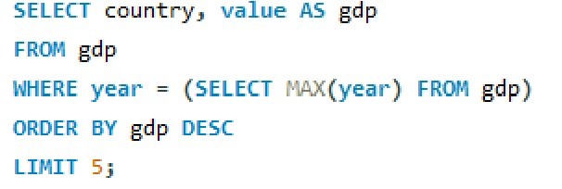
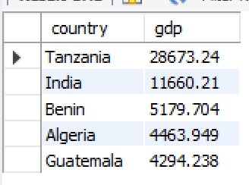
What are the top 5 countries by GDP in the most recent year?
Tanzania has the highest GDP (28,673.24) in this list, significantly higher than the others, indicating stronger economic output among these countries.
The remaining countries — Benin, Algeria, and Guatemala — have moderate and relatively similar GDP levels, indicating comparable economic scales in this group.

Slide 11
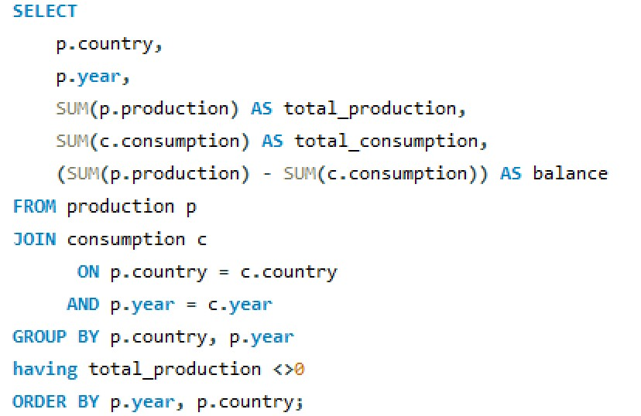
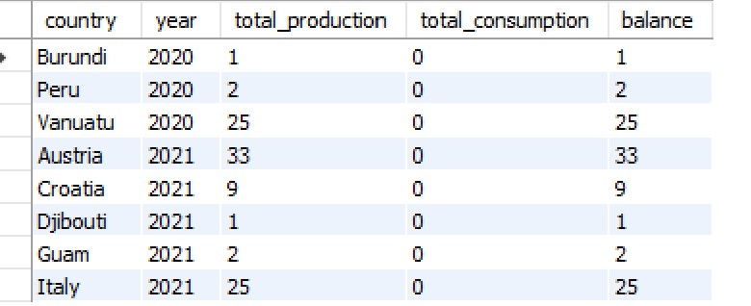
Compare energy production and consumption by country and year.
Austria has the highest production balance (33 in 2021), indicating the largest surplus among the group.
Smaller producers like Burundi and Djibouti have minimal surplus, reflecting lower production capacity.
The data spans 2020–2021, showing that surplus production occurs across different years and regions.

Slide 12
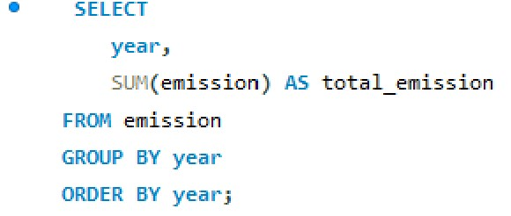
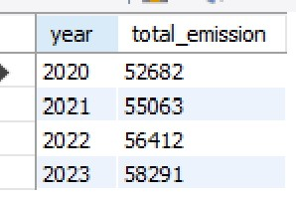
How global emissions changed year over year?
Total emissions are increased over the year 2020 – 2023.
The emissions rise each year with the largest jump between 2020 and 2021 and smallest between 2021 and 2022.

Slide 13
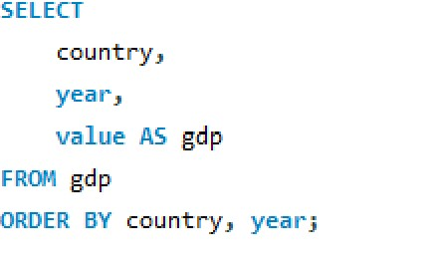
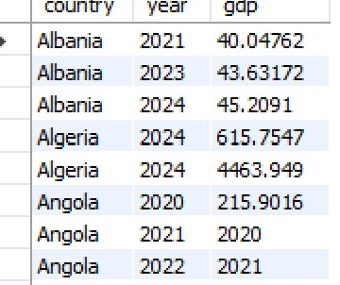
What is the trend in GDP for each country over the given years?
GDP rises steadily from 40.05 in 2021 to 45.21 in 2024, indicating about 12.8% growth over the three years.
The data shows GDP of 215.90 in 2020, but the next two rows have the years and GDP values swapped (2020 and 2021 appear as GDP figures). This likely indicates a data entry mistake.

Slide 14
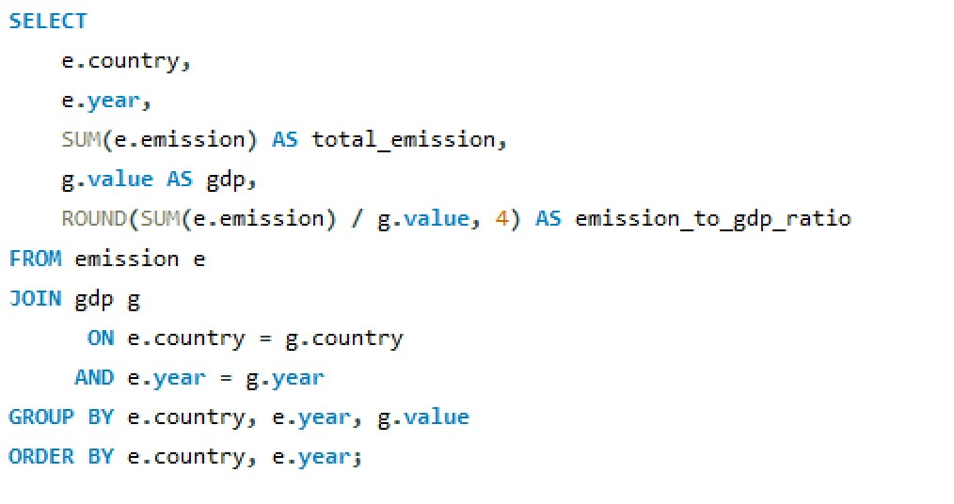
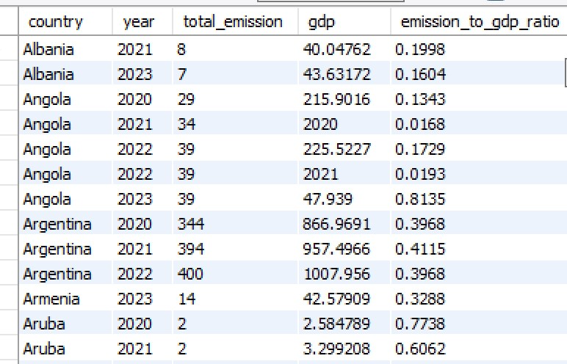
What is the emission-to-GDP ratio for each country by year?
Albania is becoming more carbon-efficient - generating more economic output per unit of emissions.
Argentina’s economic growth is closely tied to emission growth - limited decoupling observed.

Slide 15
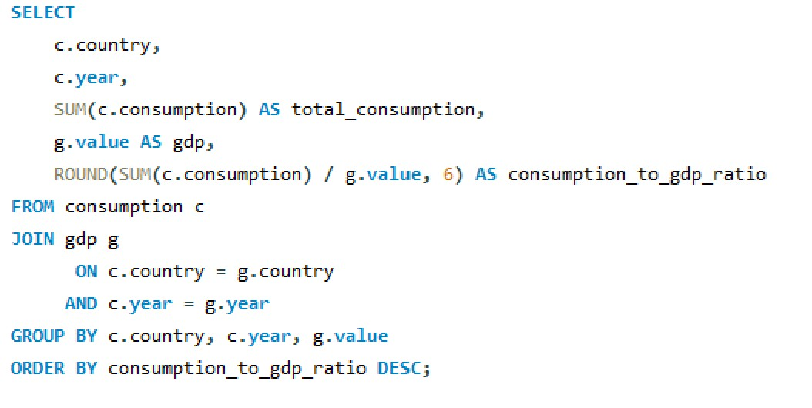
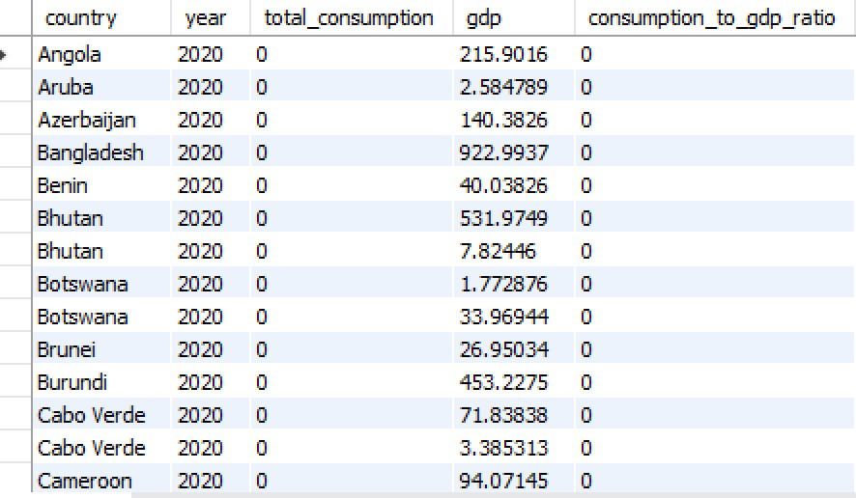
Which countries have the highest energy consumption relative to GDP?
The zero values in total consumption_ suggest the data is either unavailable, not recorded, or not applicable for these countries in 2020.
The gdp column contains non‑zero figures, indicating economic output data is available.

Slide 16
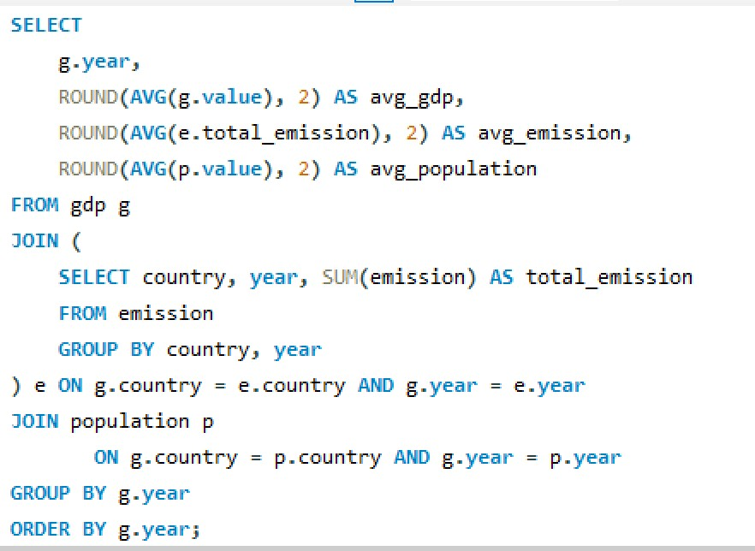
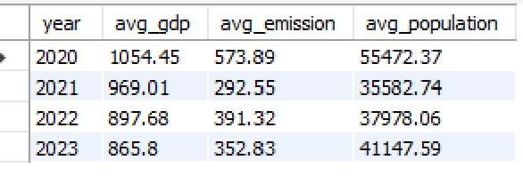
What is the global average GDP, emission, and population by year?
Avg gdp declines steadily from 1054.45 (2020) to 865.8 (2023), indicating a downward economic performance over the period.
Avg emission drops sharply from 573.89 in 2020 to 292.55 in 2021, then rises in 2022 (391.32) and falls again in 2023 (352.83), suggesting fluctuating emission levels.

Slide 17
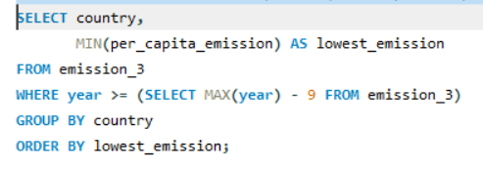
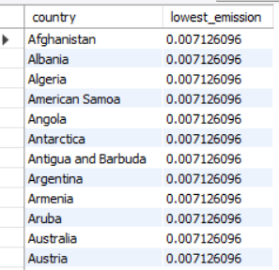
Countries reducing per capita emissions over time.
The “lowest emission” column lacks variation, making the data unusable for comparative analysis.
The list includes diverse geographic regions (e.g., Antarctica, American Samoa), hinting at a global dataset.
Verification of the source or data-cleaning steps is needed to replace these placeholders with actual emission values.

Slide 18

SQL Query Results & Insights
• Most recent year total emissions show leading contributors.
• GDP rankings highlight economic powerhouses.
• Net energy balance shows dependency vs surplus.
• Yearly trends reveal increasing consumption in major economies.
• Per capita metrics provide fairness of energy distribution.
• Global comparisons highlight inequalities.

Slide 19

Final Business Insights & Recommendations
• High emissions concentrated in top economies.
• Renewable energy adoption critical for reducing per capita emissions.
• Countries with rapid population growth face higher energy demand.
• Major economies must focus on balancing production & consumption.
• Data-driven policies can ensure sustainable global development.

Slide 20

Conclusion
• SQL-based database helps analyze global energy and emissions.
• Provides insights into GDP, population, and consumption trends.
• Identifies countries leading in emissions and energy use.
• Useful for policy makers, environmental researchers, and energy planners.

Slide 21

Experience & Challenges
• Designing schema to capture multi-dimensional data (GDP, Population, Energy).
• Ensuring referential integrity with foreign keys.
• Handling missing/incorrect year data.
• Writing queries with complex joins & calculations.
• Interpreting large dataset results into actionable insights.

Slide 22


